Slide 1

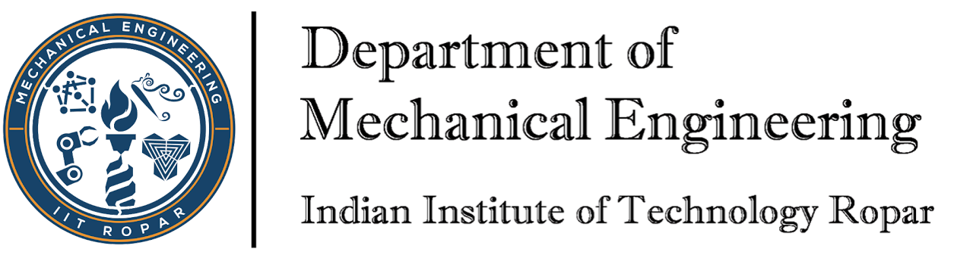

ME306
Design Lab - II
Submitted by
Group Mon(C)
Mehboob Alam (2022MEB1323)
Sahil Mhapsekar (2022MEB1324)
Mili Prajapati (2022MEB1325)
Mohit Sharma (2022MEB1326)
Palakpreet Kaur (2022MEB1327)

Slide 2

Title of project –
Simulink Model of a Self-Balancing Robot Using PID Control

Slide 3
Objective
Design and simulate a self-balancing robot using MATLAB Simulink.
Understand feedback control principles using a PID controller to stabilize the robot
As Balancing a two-wheeled robot is challenging due to instability so, using MATLAB Simulink and a PID controller, we test how well the robot can stay upright under disturbances.

Slide 4
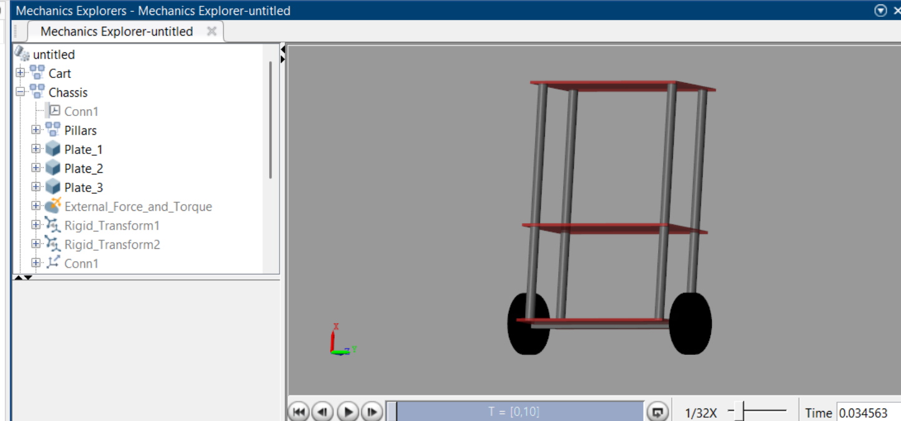
System Modelling using Simscape Multibody :
We Generated a 3D model with three horizontal plates, four vertical rods, and two wheels.
Simscape Multibody helps visualize and simulate physical movements.

Slide 5
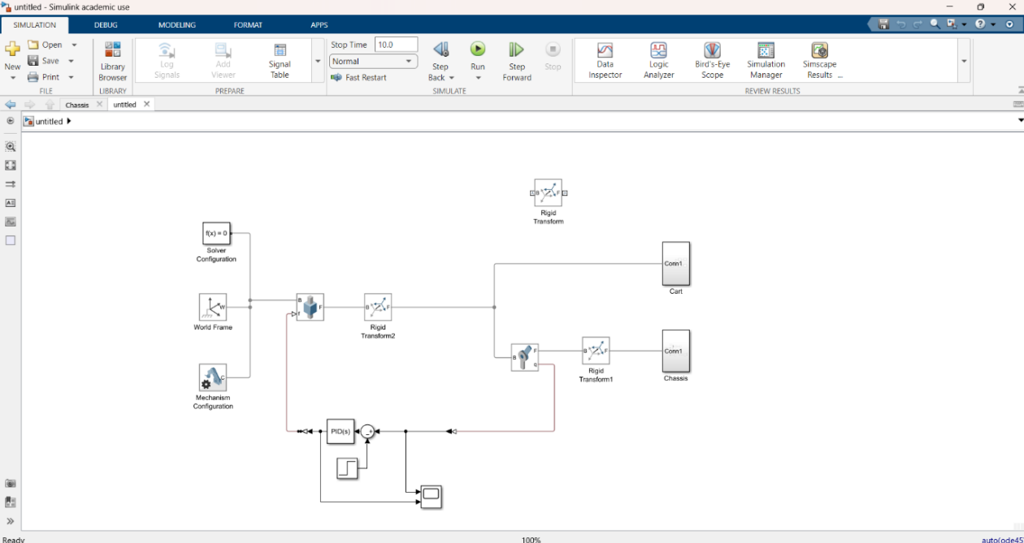
Project Description:

Slide 6
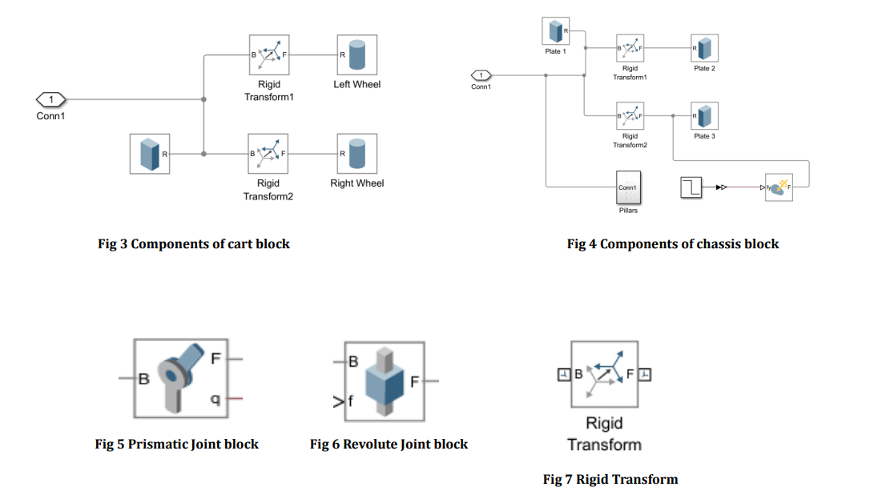

Slide 7
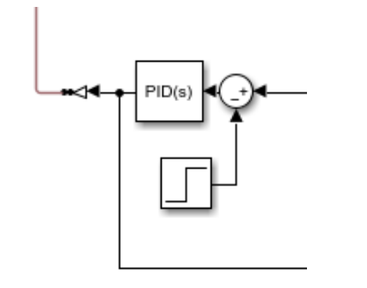
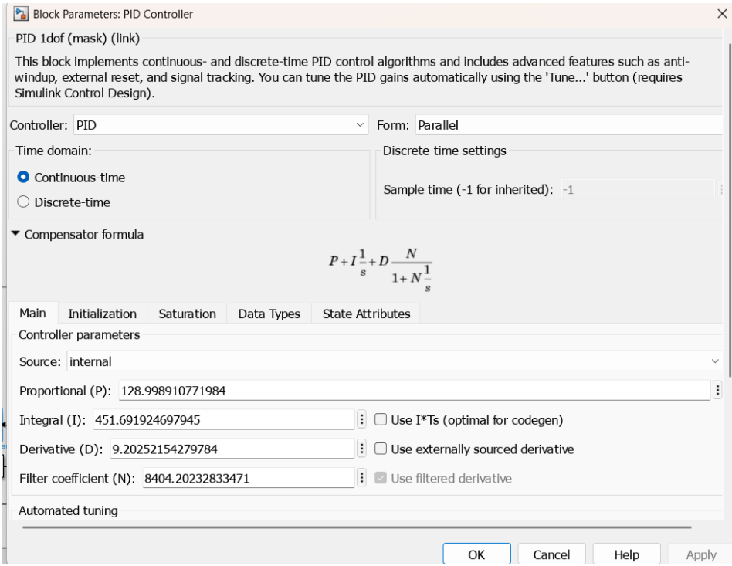
Control system
The control system is the core of the self-balancing mechanism. It senses the pendulum angle, compares it with the desired angle (usually zero), and then calculates the force needed to keep the pendulum balanced.

Slide 8
Summary of Simulation:
The simulation begins with the robot at rest.
The step input provides an initial tilt to the pendulum.
The sensors measure the angle and feed it back to the controller.
The PID controller calculates the necessary force to apply.
The cart moves in response to the control signal.
The pendulum swings back toward the vertical position.
Over time, the pendulum angle stabilizes near zero, showing successful balancing.
The simulation runs until the stop time (10 seconds in our model).

Slide 9
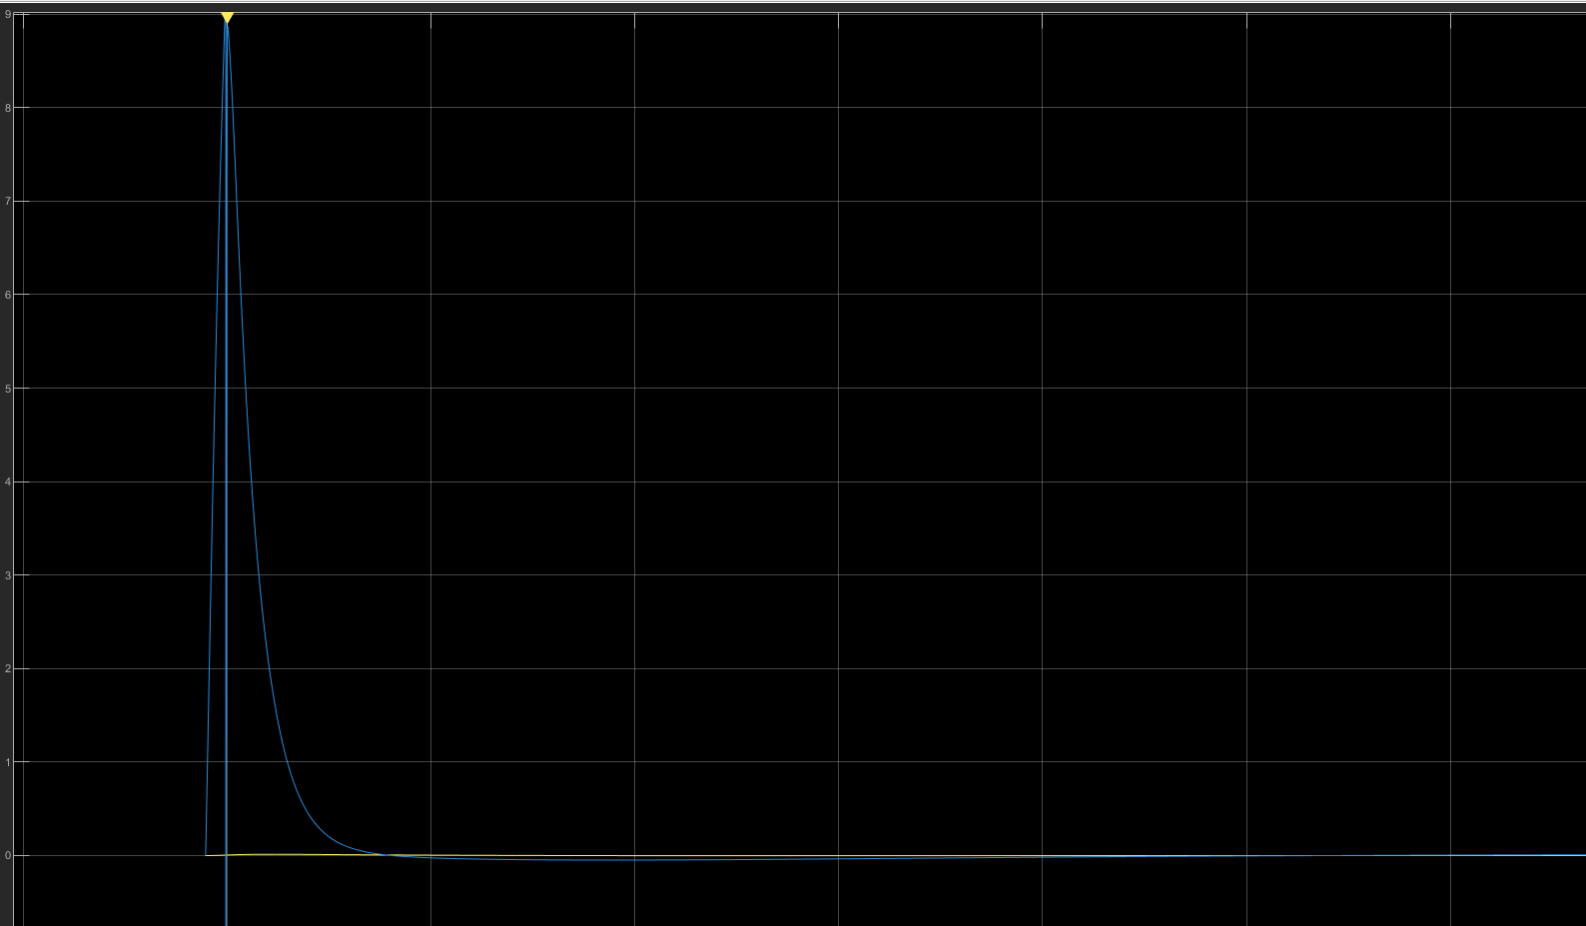
Outputs:
Plot betweenTime (x axis) vs Angular Position (θ) (y axis) in degrees from the Scope block, showing the pendulum angle returning to zero, indicating successful self-balancing by the control system.

Slide 10


